Slide 1
CS 4530: Fundamentals of Software Engineering Module 9.1 Distributed Systems: Goals and Challenges
Adeel Bhutta, Mitch Wand
Khoury College of Computer Sciences
© 2023 Released under the CC BY-SA license

Slide 2
Learning Goals for this Lesson
At the end of this lesson you should be able to
List and define 5 goals of using distributed systems
List 4 major challenges inherent in distributed systems

Slide 3





What is a distributed system?
Model One:
Many servers talking through a network
Model Two:
Many servers and clients talking through a network
Notes:
First: some ground rules. What is a distributed system? Most apps that we work with are distributed in some way, at least in the sense that there is some code that runs in a client, and elsewhere on a server. For this and the following lesson, however, we’ll focus primarily on what happens when the server code needs to be distributed across multiple computers, with a network connecting them.

Slide 4
Distributed Systems Goals
Scalability
Performance
Latency
Availability
Fault Tolerance
“Distributed Systems for Fun and Profit”, Takada
Notes:
Why go through the effort of implementing, deploying and maintaining a distributed system? Here are the general goals a DS should address.
This is list is taken from “Distributed Systems for Fun and Profit”, by Takada, which is a really excellent summary; it’s available online; the link is in the PowerPoint or you can just search for it.
For now, it should suffice to recognize the most common advantages that may come from moving to a distributed system.

Slide 5
Distributed Systems Goals
Scalability
Performance
Latency
Availability
Fault Tolerance
“the ability of a system, network, or process, to handle a growing amount of work in a capable manner or its ability to be enlarged to accommodate that growth.”
“Distributed Systems for Fun and Profit”, Takada
Notes:
The first advantage is scalability.
Most things are easy to do small: Let’s make a system that lets 5 people run around a 2D map. Great! How do we let 100,000 people run around that same map? Uh-oh. A scalable system is one in which we can scale the resources available to the system up in a way that is hopefully sub-linear to the scale in demand for usage. If our software can’t be distributed over multiple computers, then we are limited in scale to the resources that a single large computer can provide.

Slide 6
Distributed Systems Allow Horizontal Scaling
“Vertical” scaling: add more resources to existing server
Faster CPUs, more CPU cores, more RAM, more storage
Becomes ineffective : Clock speed plateaus; difficult to write applications that utilize 256 CPU cores (though adding 2TB RAM to a server can often help)
“Horizontal” scaling: add more servers
Rely on “commodity” servers rather than state-of-the-art hardware
Allows for dynamic addition of resources as needed by load
Notes:
There are two basic strategies for scaling a system <read slide>.

Slide 7
Distributed Systems Goals
Scalability
Performance
Latency
Availability
Fault Tolerance
“The amount of useful work accomplished by a computer system compared to the time and resources used.”
“Distributed Systems for Fun and Profit”, Takada
Notes:
Distributed Systems can improve performance.
Performance is measured perhaps by throughput (how much work gets done), but also in terms of resources we are using to attain that throughput. (for example, are we using an enormous amount of resources to achieve this throughput?)

Slide 8
Multiple Servers Can Improve Throughput With Concurrency
Throughput: total requests that can be processed per unit-time
Facebook.com
Request
Cache Check
Build friends list
Build Newsfeed
Build Suggestions
Send response
Response
Request
Facebook.com
Response
Cache Check
Build friends list
Build Newsfeed
Build Suggestions
Send response
Build friends list
Build Newsfeed
Build Suggestions
Notes:
Distributed systems can improve throughput through concurrency. If we can create a system that uses more machines to do more work concurrently, then we can satisfy more requests in the same amount of time.
The figure shows a way to (theoretically) double the throughput of a site like Facebook. Serving a request might require a few different key steps to occur. If we could perform those steps for different requests concurrently, we can increase our throughput.
Note that we could implement the concurrency on a single node. But, eventually we will reach the limitations of how many things can be done at once on a single server - and then we will need to consider distributing the work to multiple nodes.

Slide 9
Distributed Systems Goals
Scalability
Performance
Latency
Availability
Fault Tolerance
The time during which something that has already happened is concealed from view.
In a multi-server system, we can select a server that is closer to the user.
“Distributed Systems for Fun and Profit”, Takada
Notes:
Latency captures response time. How long does it take between a user making a request and receiving their response?

Slide 10
Reduce latency by distributing data
Move or replicate the data
Avoid bottlenecks
Decrease transmission time
“Distributed Systems for Fun and Profit”, Takada
Notes:
In a distributed system, we can distribute the data across multiple servers. This could avoid bottlenecks where one server needs to handle many requests. Another benefit is that we could move the data and its server to a location that is physically close to the client, which could mitigate transmission delays– the speed of light, and all that.

Slide 11
Distributed Systems Goals
Scalability
Performance
Latency
Availability
Fault Tolerance
“the proportion of time a system is in a functioning condition.”
Availability = uptime / (uptime + downtime).
Often measured in “nines”
Availability % | Downtime/year
90% | >1 month
99% | < 4 days
99.9% | < 9 hours
99.99% | <1 hour
99.999% | 5 minutes
99.9999% | 31 seconds
“Distributed Systems for Fun and Profit”, Takada
Notes:
The next goal that we often try to achieve with distributed systems is availability - the proportion of time that a system is functioning.

Slide 12
Distributed Systems can improve availability by replicating servers
A single-server system is either up or down.
If you have many servers, the probability that some server is down increases
BUT: the probability that all servers are down decreases (exponentially!)
Notes:
It is hard to handle availability on a single machine We’d like to take a bunch of unreliable components and build a bigger thing that itself is reliable.
<READ SLIDE>
Let’s do some arithmetic and see how this might work out….

Slide 13
Here’s a crude quantitative model
Say there’s a 1% chance of having some hardware failure occur to a machine in a given month (power supply burns out, hard disk crashes, etc)
Now I have 10 machines
Probability(at least one fails during the month) = 1 - Probability(no machine fails) = 1-(1-.01)¹⁰ = 10%
100 machines -> 63% chance that at least one fails
Chance that all machines fail during the month: (.01)¹⁰ = 10⁻¹²
Notes:
(Read slide)
Availability considers things more broadly than uptime though: what if there is a network outage? We’ll talk about that a little later.

Slide 14
Distributed Systems Goals
Scalability
Performance
Latency
Availability
Fault Tolerance
“ability of a system to behave in a well-defined manner once faults occur”
“Distributed Systems for Fun and Profit”, Takada
Notes:
But machines and systems are not merely “up” or “down”. If something bad happens, regardless of whether the system is temporarily unavailable, our system should behave in a predictable manner: maybe it’s just slower, or maybe it emits a “try again later message”: what’s an acceptable behavior will depend on the application. For example, a game server might emit fewer frames per second, or a surveillance system might deliver lower-resolution images than a fully-functioning system does Or imagine a drone on the battlefield, where the enemy has shot off one of its cameras.

Slide 15
Design to expect faults
“Define what faults you expect and then design a system or an algorithm that is tolerant of them. You can't tolerate faults you haven't considered.”
What kind of faults?
Disks fail
Networking fails
Power supplies fail
Security breached
Power goes out
Datacenter goes offline
“Distributed Systems for Fun and Profit”, Takada
Notes:
Here some kinds of “partial failures” that you might have to design for.
This is reminiscent of “agile”: we expect that there will be failures, and our system should be designed to accommodate them.

Slide 16
Distributed Systems Challenges

Slide 17
More machines means more links that might fail.
Number of nodes + distance between them
Notes:
What makes it difficult for us to achieve these goals?
An increase in the number of independent nodes may increase the need for communication between nodes
(click)
(reducing performance as scale increases)
And links can fail, too! (click). More links, higher probability of failure.

Slide 18
Networks introduce delays
Cannot expect network to be a perfect analog for communication within a single computer because:
Speed of light (1 foot/nanosecond)
Communication links exist in uncontrolled/hostile environments
Communication links may be bandwidth limited (tough to reach even 100MB/sec)
In contrast to a single computer, where:
Distances are measured in mm, not feet
Physical concerns can be addressed all at once
Bandwidth is plentiful (easily GB/sec)
Notes:
(Read slide)

Slide 19


Worse yet, networks still fail, intermittently and for prolonged periods

Slide 20
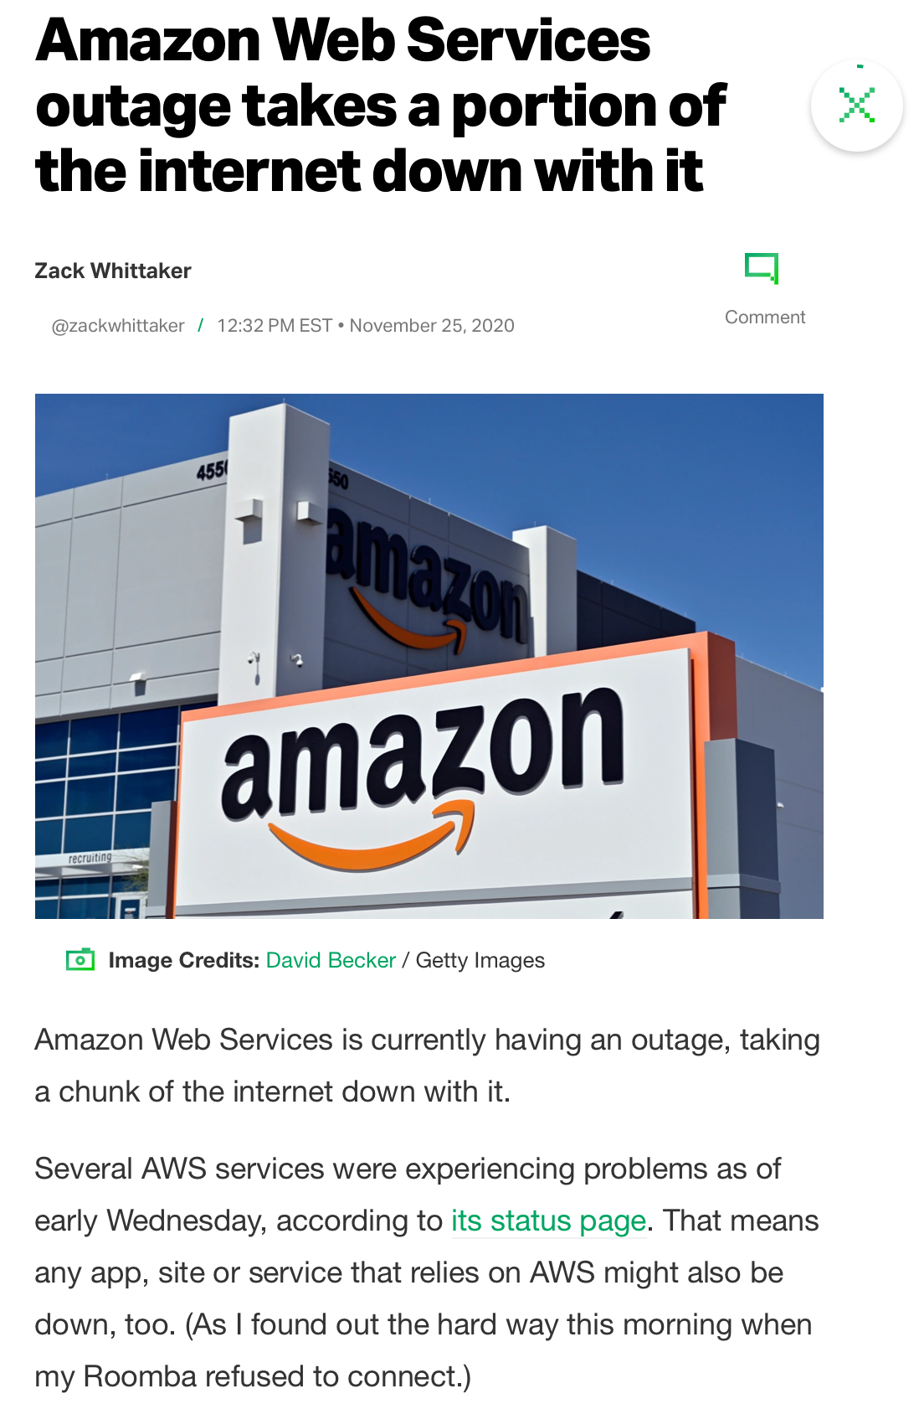
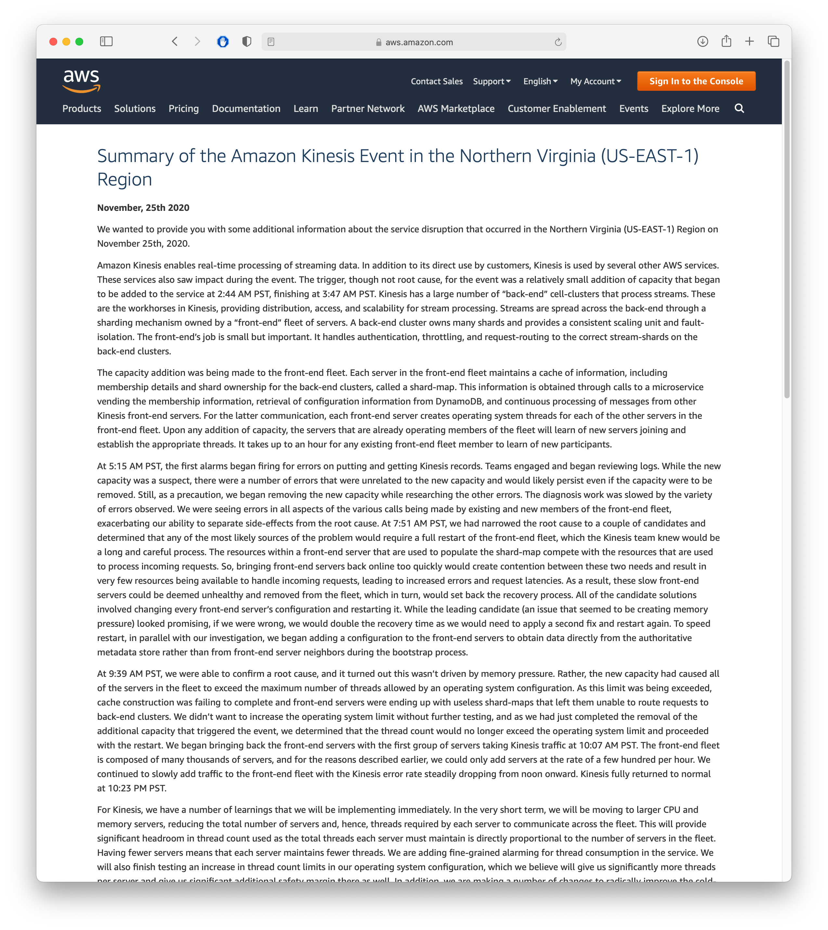
We still rely on other administrators, who are not infallible
Notes:
Once we introduce a network, we become reliant on other administrators and organizations to provide us with network service.

Slide 21
Learning Goals for this Lesson
You should now be able to
List and define 5 goals of using distributed systems
List 4 major challenges inherent in distributed systems

